Slide 1
Image Restoration

Slide 2
Outline
A model of the image degradation / restoration process
Noise models
Restoration in the presence of noise only – spatial filtering
Periodic noise reduction by frequency domain filtering
Inverse filtering

Slide 3
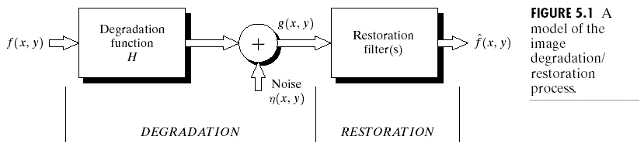
A model of the image degradation/restoration process
g(x,y)=f(x,y)*h(x,y)+η(x,y)
G(u,v)=F(u,v)H(u,v)+N(u,v)

Slide 4
Noise models
Source of noise
  Image acquisition (digitization)
  Image transmission
Spatial properties of noise
  Statistical behavior of the gray-level values of pixels
  Noise parameters, correlation with the image
Frequency properties of noise
  Fourier spectrum

Slide 5
Noise probability density functions
Noises are taken as random variables
Random variables
  Probability density function (PDF)

Slide 6
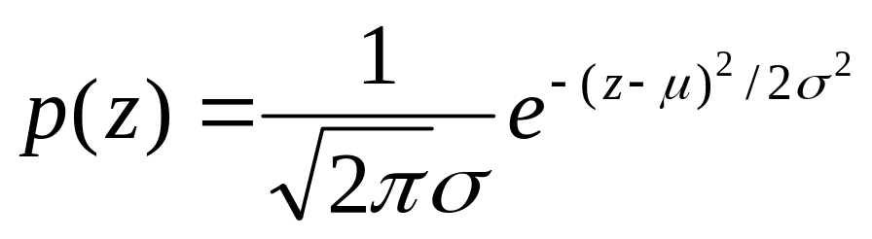
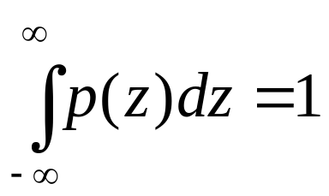
Gaussian noise
Math. tractability in spatial and frequency domain
Electronic circuit noise and sensor noise
mean
variance
Note:

Slide 7
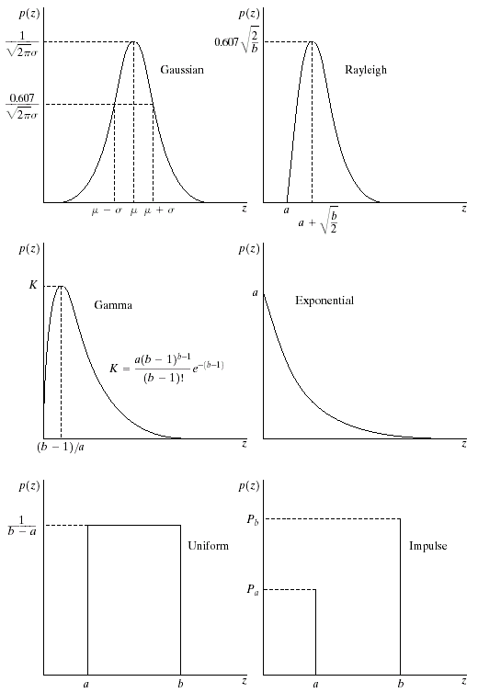
Gaussian noise (PDF)
70% in [(μ−σ), (μ+σ)]
95% in [(μ−2σ), (μ+2σ)]

Slide 8
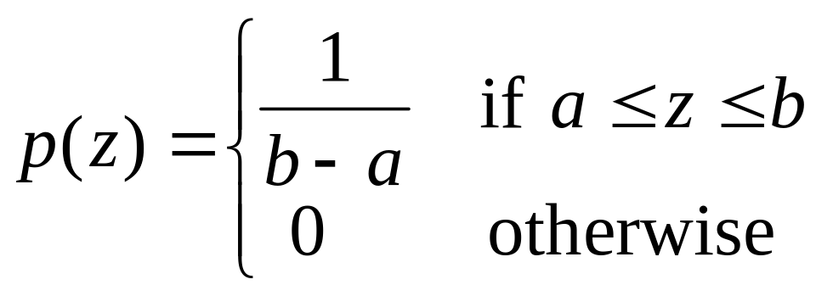
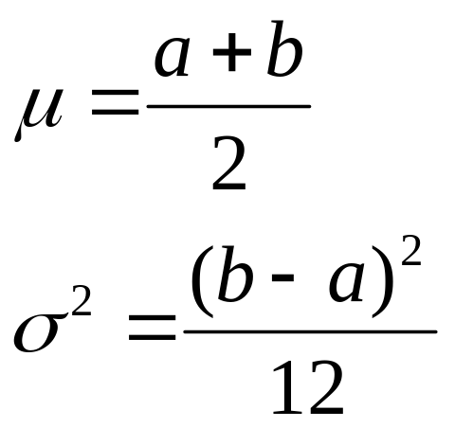
Uniform noise
Less practical, used for random number generator
Mean:
Variance:

Slide 9
Uniform PDF

Slide 10
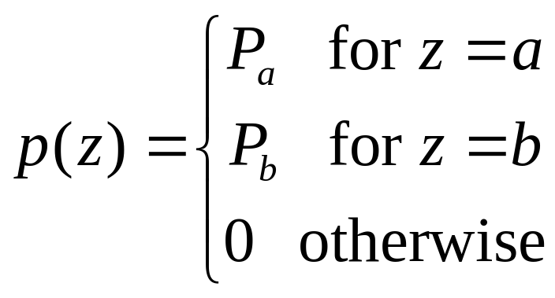
Impulse (salt-and-pepper) nosie
Quick transients, such as faulty switching during imaging
If either P_{a} or P_{b} is zero, it is called unipolar.
Otherwise, it is called bipoloar.
In practical, impulses are usually stronger than image
signals. Ex., a=0(black) and b=255(white) in 8-bit image.

Slide 11
Impulse (salt-and-pepper) nosie PDF

Slide 12
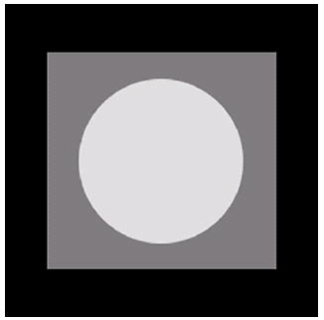
Test for noise behavior
Test pattern
Its histogram:
0
255

Slide 13
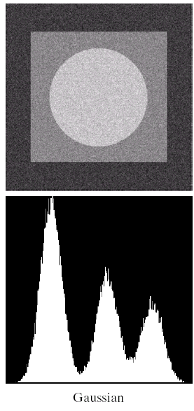
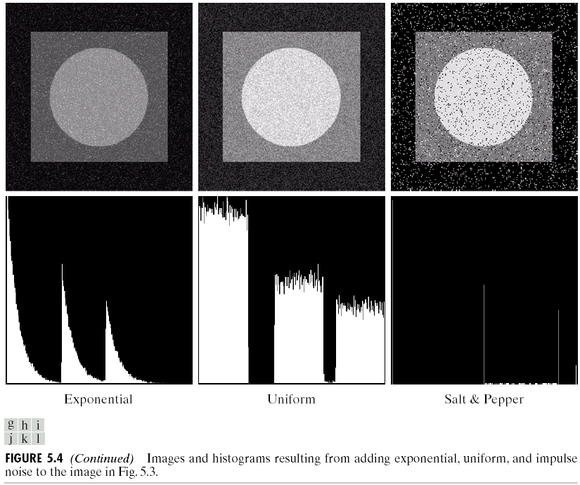

Slide 14
Periodic noise
Arise from electrical or electromechanical interference during image acquisition
Spatial dependence
Observed in the frequency domain

Slide 15
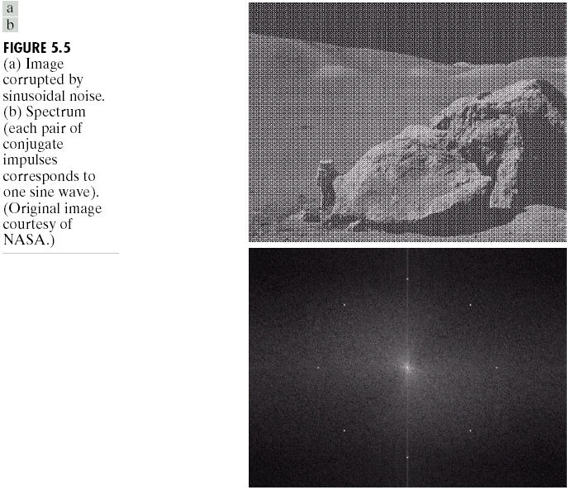
Sinusoidal noise:
Complex conjugate
pair in frequency
domain

Slide 16
Estimation of noise parameters
Periodic noise
  Observe the frequency spectrum
Random noise with unknown PDFs
  Case 1: imaging system is available
    Capture images of “flat” environment
  Case 2: noisy images available
    Draw the histogram and observe it
    Measure the mean and variance

Slide 17
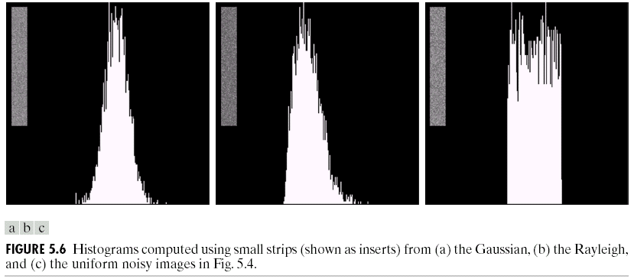
Observe the histogram
Gaussian
uniform

Slide 18
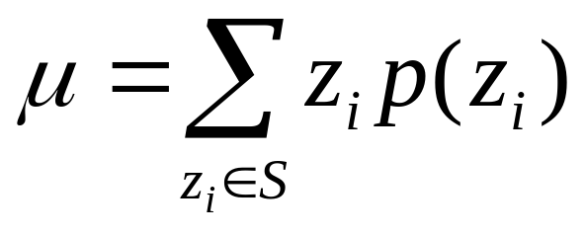
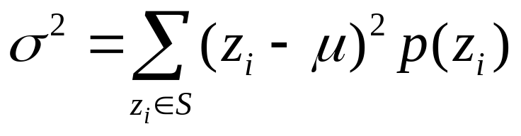
Measure the mean and variance
Histogram is an estimate of PDF
Gaussian: μ, σ
Uniform: a, b
⬄

Slide 19
Outline
A model of the image degradation / restoration process
Noise models
Restoration in the presence of noise only – spatial filtering
Periodic noise reduction by frequency domain filtering
Inverse filtering

Slide 20
Additive noise only
g(x,y)=f(x,y)+η(x,y)
G(u,v)=F(u,v)+N(u,v)

Slide 21
Spatial filters for de-noising additive noise
Skills similar to image enhancement
Mean filters(linear filters)
Order-statistics filters(Non linear filter)
Adaptive filters

Slide 22
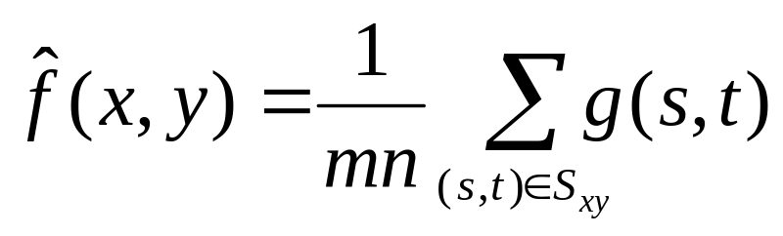
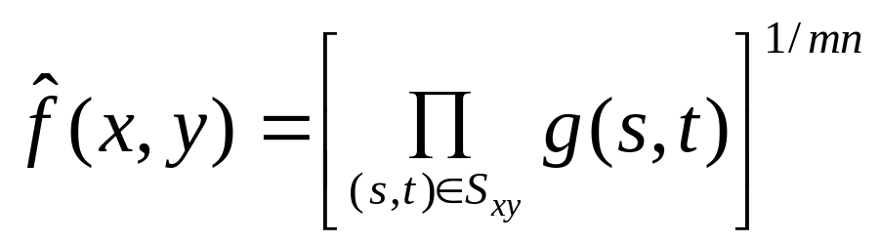
Mean filters
Arithmetic mean
Geometric mean
Window centered at (x,y)

Slide 23
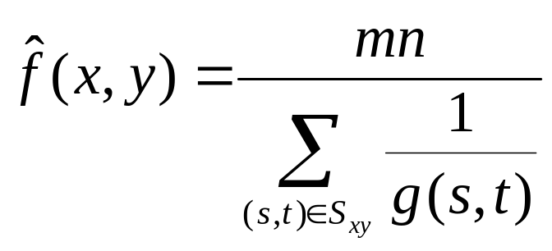
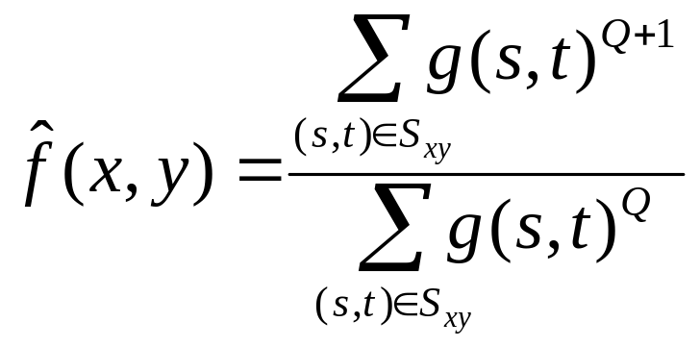
Mean filters (cont.)
Harmonic mean filter
Contra-harmonic mean filter
Q=-1, harmonic
Q=0, airth. mean
Q=+, ?

Slide 24
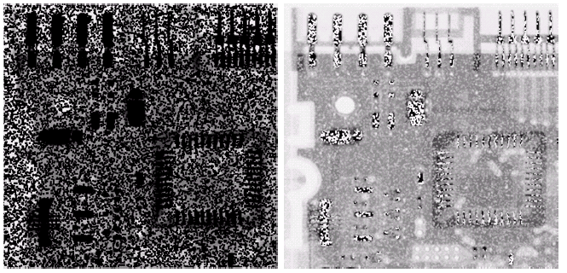
Wrong sign in contra-harmonic filtering
Q=-1.5
Q=1.5

Slide 25
Order-statistics filters
Based on the ordering(ranking) of pixels
  Suitable for unipolar or bipolar noise (salt and pepper noise)
Median filters
Max/min filters
Midpoint filters
Alpha-trimmed mean filters

Slide 26
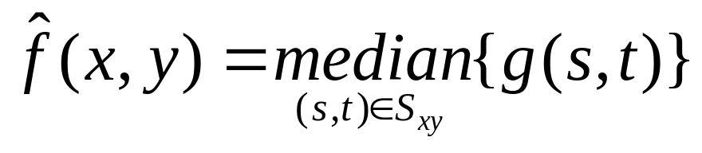
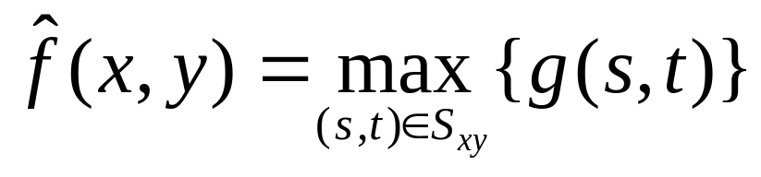
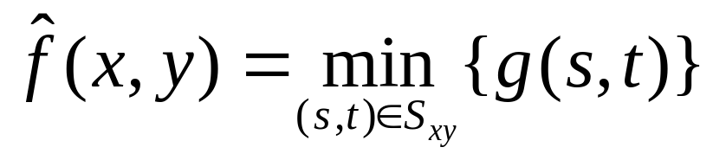
Order-statistics filters
Median filter
Max/min filters

Slide 27
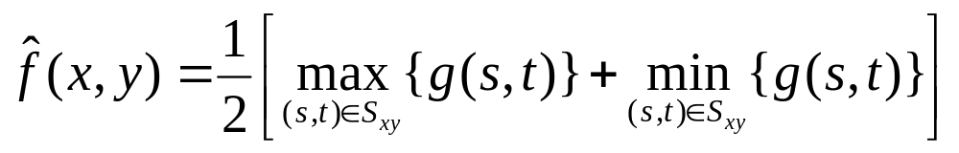
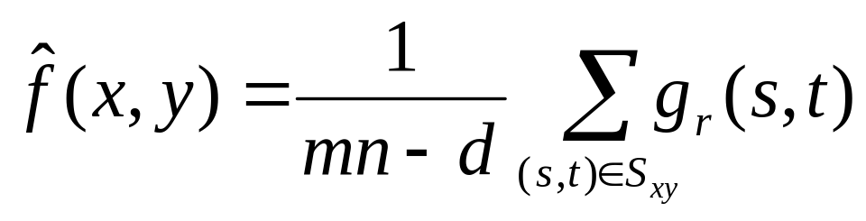
Order-statistics filters (cont.)
Midpoint filter
Alpha-trimmed mean filter
  Delete the d/2 lowest and d/2 highest gray-level pixels
Middle (mn-d) pixels

Slide 28
Adaptive filters
Adapted to the behavior based on the statistical characteristics of the image inside the filter region S_{xy}
Improved performance v.s increased complexity
Example: Adaptive local noise reduction filter

Slide 29
Adaptive local noise reduction filter
Simplest statistical measurement
  Mean and variance
Known parameters on local region S_{xy}
  g(x,y): noisy image pixel value
  σ²_{η}: noise variance (assume known a prior)
  m_{L} : local mean
  σ²_{L} : local variance

Slide 30
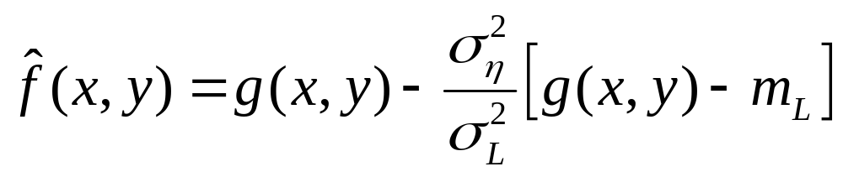
Adaptive local noise reduction filter (cont.)
Analysis: we want to do
  If σ²_{η} is zero, return g(x,y)
  If σ²_{L}> σ²_{η} , return value close to g(x,y)
  If σ²_{L}= σ²_{η} , return the arithmetic mean m_{L}
Formula

Slide 31
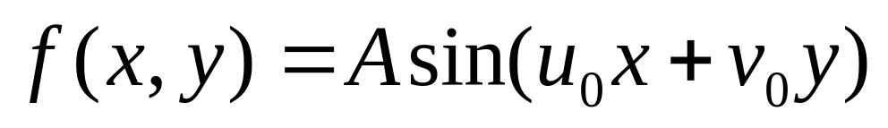
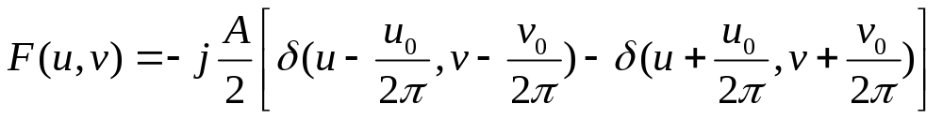
Periodic noise reduction
Pure sine wave
  Appear as a pair of impulse (conjugate) in the frequency domain

Slide 32
Periodic noise reduction (cont.)
Bandreject filters
Bandpass filters
Notch filters

Slide 33
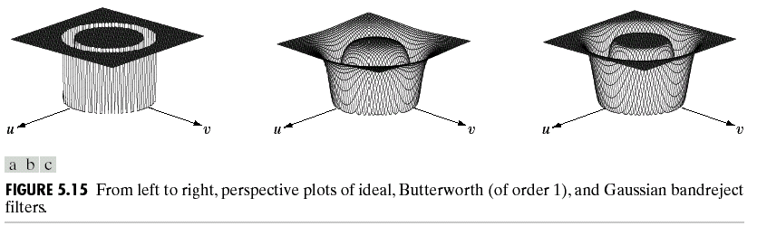
Bandreject filters
* Reject an isotropic frequency
ideal
Butterworth
Gaussian

Slide 34
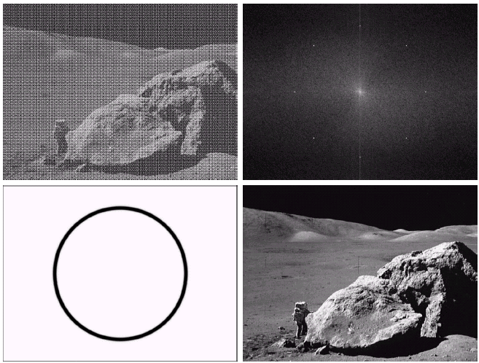
noisy
spectrum
filtered
bandreject

Slide 35
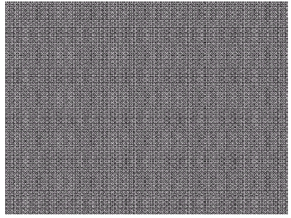
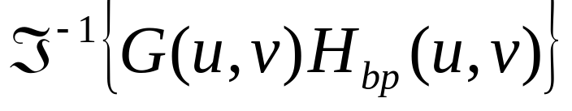
Bandpass filters
H_{bp}(u,v)=1- H_{br}(u,v)

Slide 36
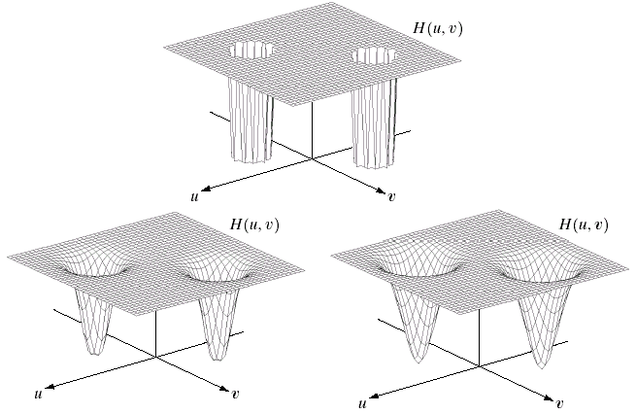
Notch filters
Reject(or pass) frequencies in predefined neighborhoods about a center frequency
ideal
Butterworth
Gaussian

Slide 37
Outline
A model of the image degradation / restoration process
Noise models
Restoration in the presence of noise only – spatial filtering
Periodic noise reduction by frequency domain filtering
Inverse filtering

Slide 38
A model of the image degradation /restoration process
g(x,y)=f(x,y)*h(x,y)+η(x,y)
G(u,v)=F(u,v)H(u,v)+N(u,v)
If linear, position-invariant system

Slide 39
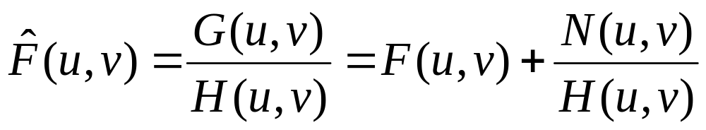
Inverse filtering
With the estimated degradation function H(u,v)
Unknown
noise
G(u,v)=F(u,v)H(u,v)+N(u,v)
=>
Estimate of
original image
Problem: 0 or small values
Sol: limit the frequency
around the origin

